Slide 1
4.1 STANDARD ETHERNET
The original Ethernet was created in 1976 at Xerox’s Palo Alto Research Center (PARC). Since then, it has gone through four generations.. We briefly discuss the Standard (or traditional) Ethernet in this section.

Slide 2
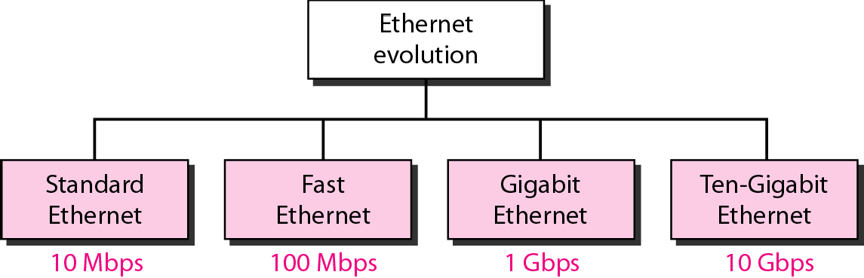
Figure 4.1.1: Ethernet evolution through four generations

Slide 3
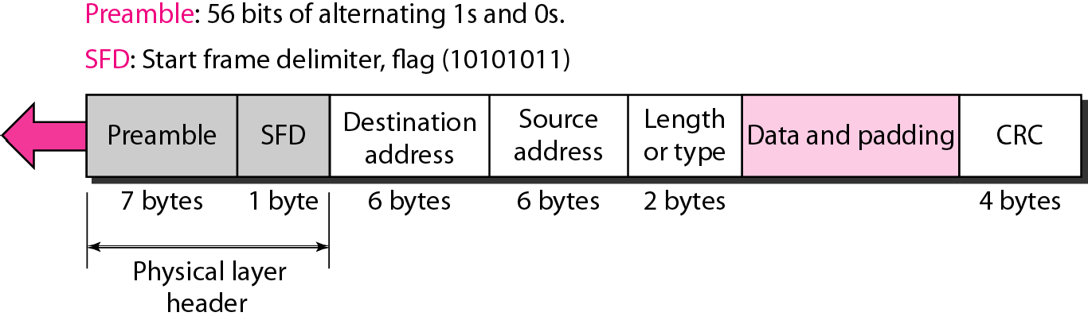
Figure 4.1.2802.3 MAC frame

Slide 4
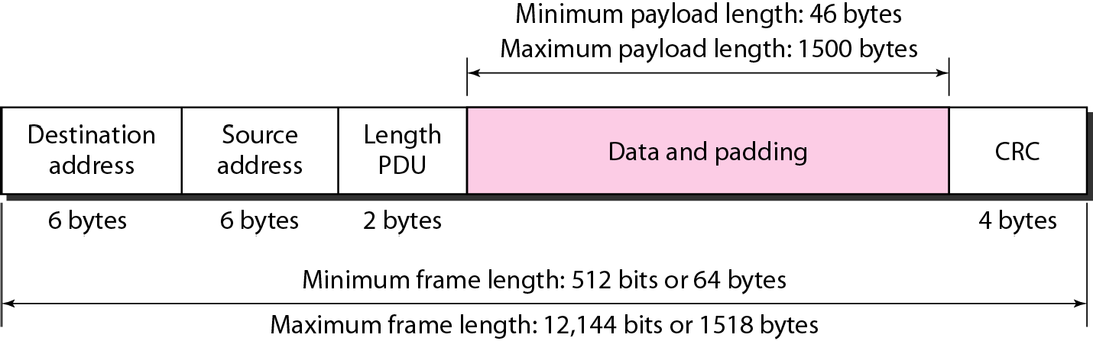
Figure 4.1.3: Minimum and maximum lengths

Slide 5

Note
Frame length: Minimum: 64 bytes (512 bits)
Maximum: 1518 bytes (12,144 bits)

Slide 6
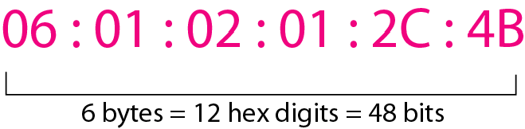
Figure 4.1.4 Example of an Ethernet address in hexadecimal notation

Slide 7
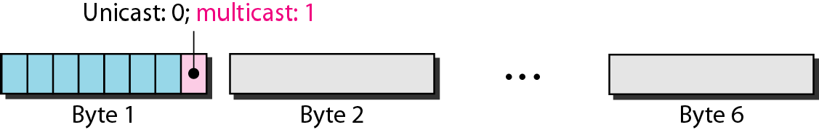
Figure4.1.5 Unicast and multicast addresses

Slide 8
Note
The least significant bit of the first byte defines the type of address.
If the bit is 0, the address is unicast; otherwise, it is multicast.

Slide 9
Note
The broadcast destination address is a special case of the multicast address in which all bits are 1s.

Slide 10
Example 4.1.1
Define the type of the following destination addresses:
a 4A:30:10:21:10:1A
b 47:20:1B:2E:08:EE
c. FF:FF:FF:FF:FF:FF Solution
To find the type of the address, we need to look at the second hexadecimal digit from the left. If it is even, the address is unicast. If it is odd, the address is multicast. If all digits are F’s, the address is broadcast. Therefore, we have the following:
This is a unicast address because A in binary is 1010.
This is a multicast address because 7 in binary is 0111.
This is a broadcast address because all digits are F’s.

Slide 11
Example 4.1.2
Show how the address 47:20:1B:2E:08:EE is sent out on line.
Solution
The address is sent left-to-right, byte by byte; for each byte, it is sent right-to-left, bit by bit, as shown below:

Slide 12
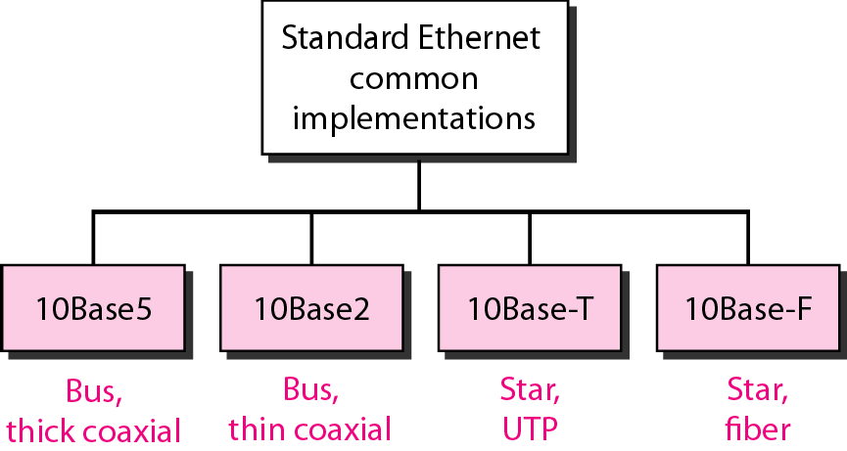
Figure 4.1.6 Categories of Standard Ethernet

Slide 13
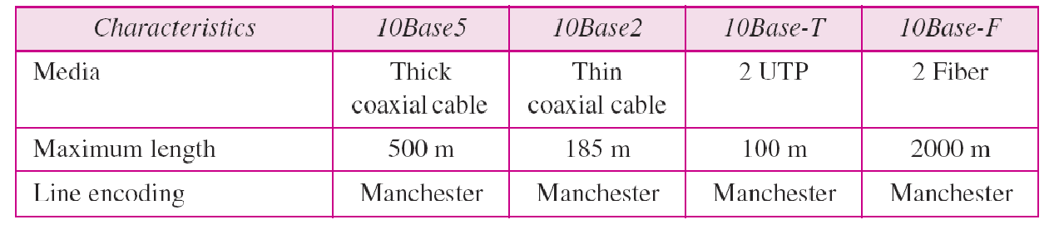
Table 4.1.1 Summary of Standard Ethernet implementations

Slide 14
4.2 CHANGES IN THE STANDARD
The 10-Mbps Standard Ethernet has gone through several changes before moving to the higher data rates.. These changes actually opened the road to the evolution of the Ethernet to become compatible with other high-data-rate LANs..
Topics discussed in this section:
Bridged Ethernet Switched Ethernet Full-Duplex Ethernet

Slide 15
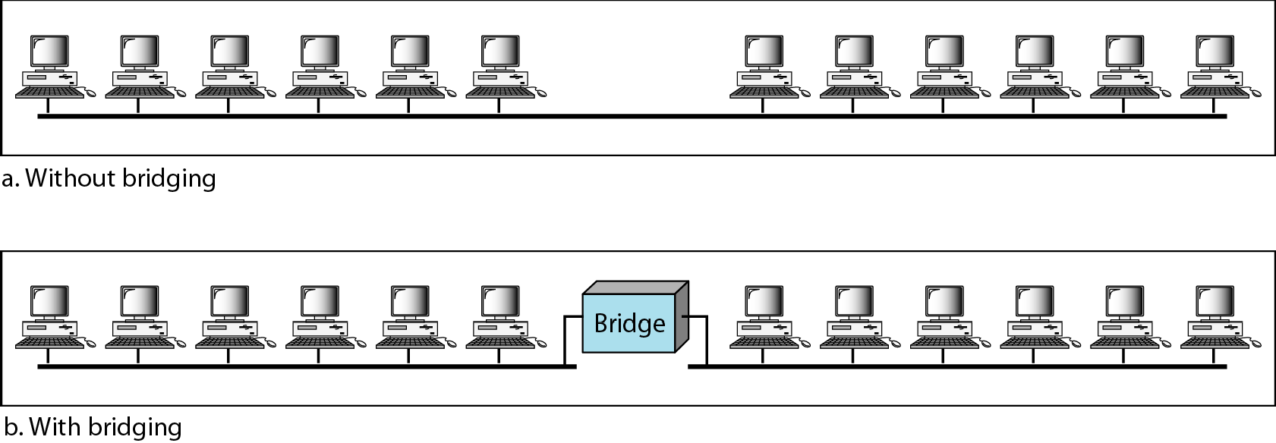
Figure 4.2.1 A network with and without a bridge

Slide 16
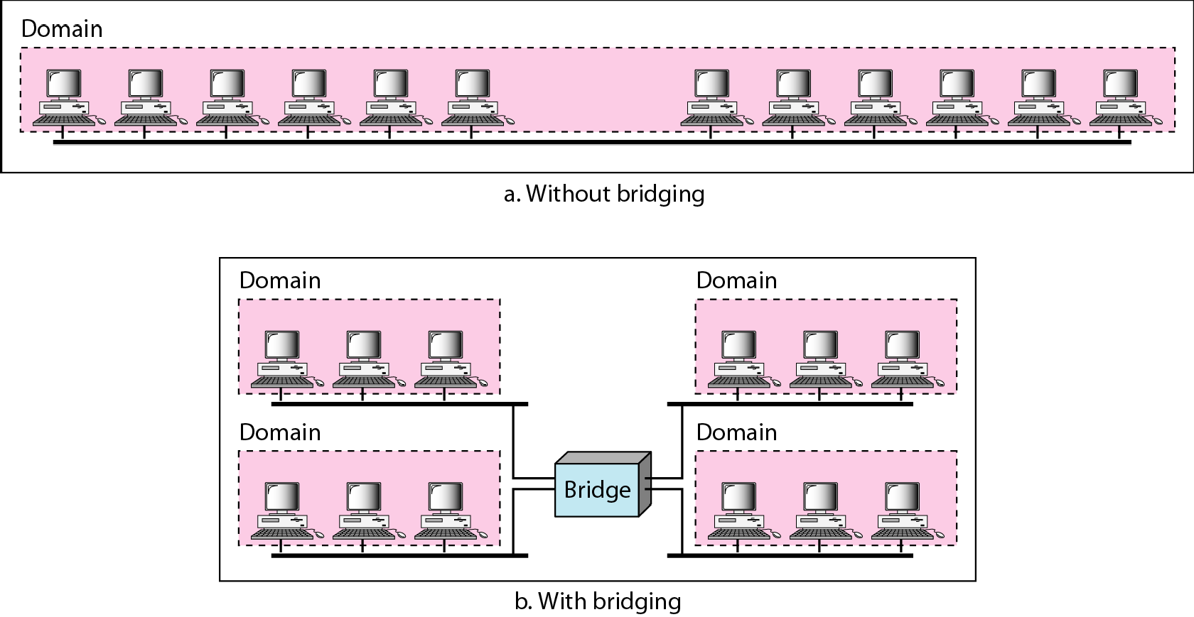
Figure 4.2.2 Collision domains in an unbridged network and a bridged network

Slide 17
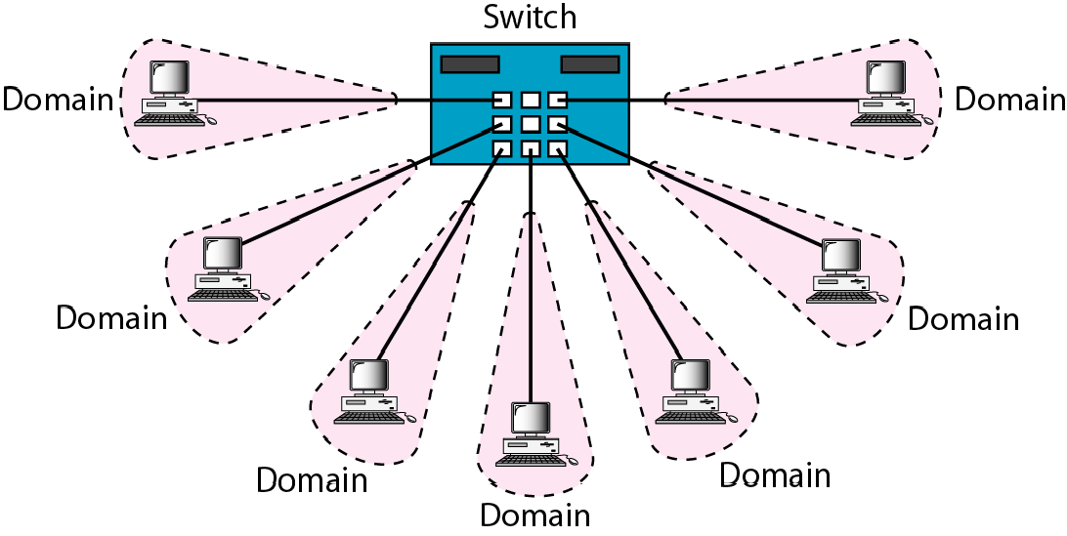
Figure 4.2.3 Switched Ethernet

Slide 18
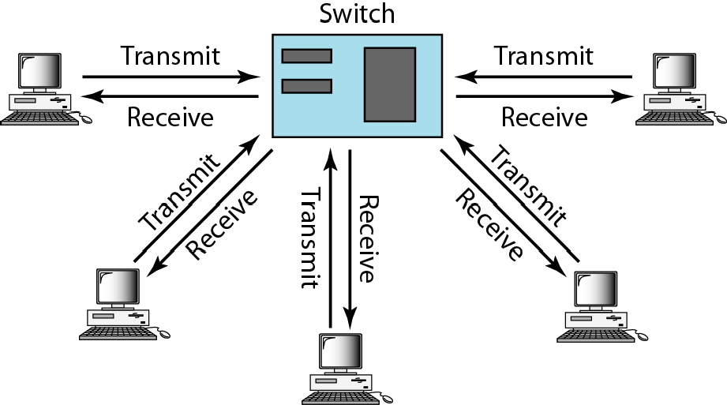
Figure 4.2.4 Full-duplex switched Ethernet

Slide 19
4.3 FAST ETHERNET
Fast Ethernet was designed to compete with LAN protocols such as FDDI or Fiber Channel. IEEE created Fast Ethernet under th nam 80 .. u.. Fast Ethernet is backward-compatible with Standard Ethernet, but it can transmit data 10 times faster at a rate of 100 Mbps.
Topics discussed in this section:
MAC Sublayer Physical Layer

Slide 20
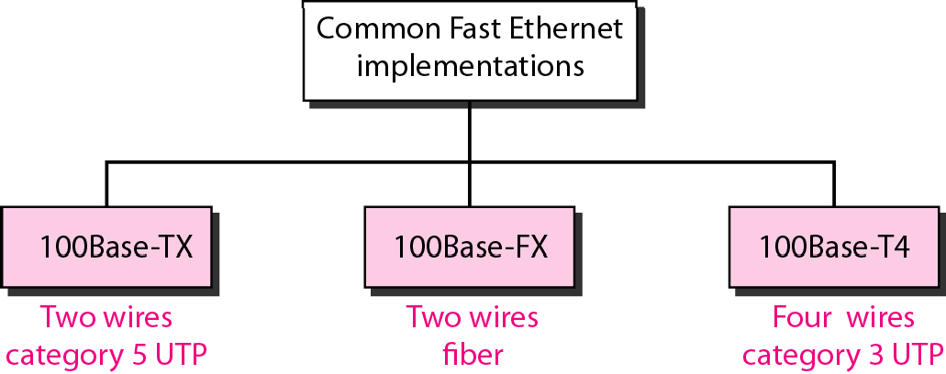
Figure 4.3.1 Fast Ethernet implementations

Slide 21
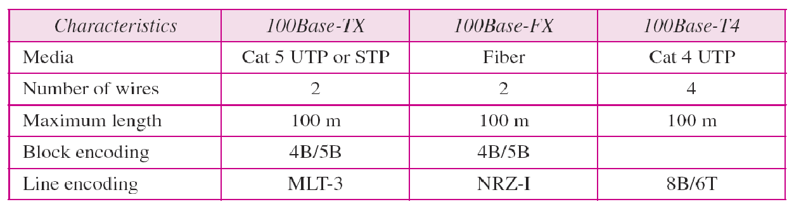
Table 4.2 Summary of Fast Ethernet implementations

Slide 22
4.4 GIGABIT ETHERNET
The need for an even higher data rate resulted in the design of the Gigabit Ethernet protocol (1000 Mbps). The IEEE committee calls the standard 802..3z..
Topics discussed in this section:
MAC Sublayer Physical Layer
Ten-Gigabit Ethernet

Slide 23

Note
In the full-duplex mode of Gigabit Ethernet, there is no collision;
the maximum length of the cable is determined by the signal attenuation in the cable.

Slide 24
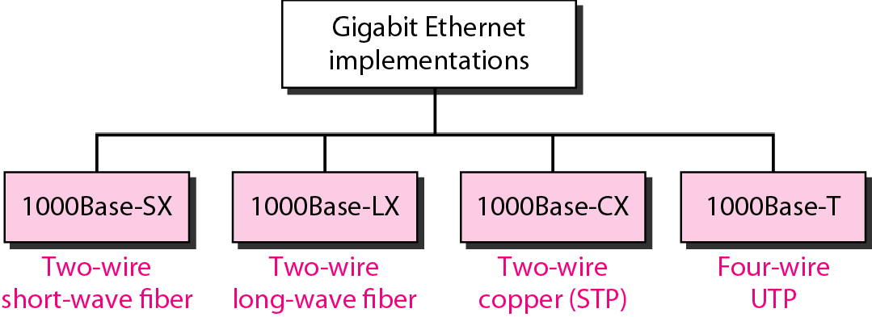
Figure 4.4.1 Gigabit Ethernet implementations

Slide 25
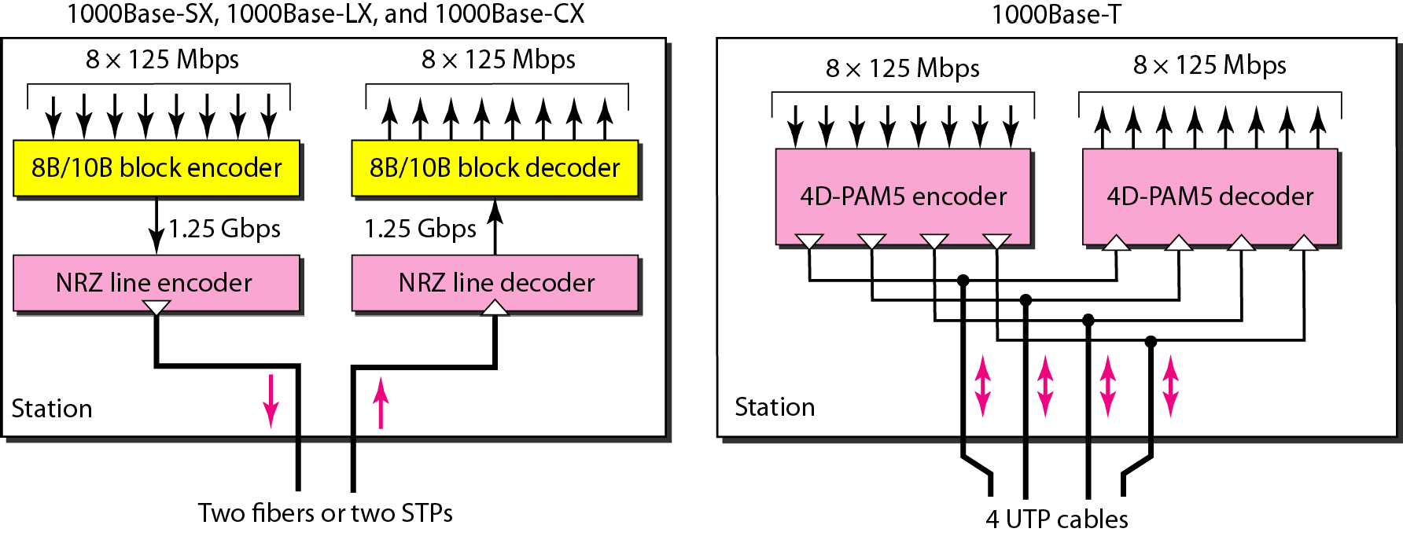
Figure 4.4.2 Encoding in Gigabit Ethernet implementations

Slide 26
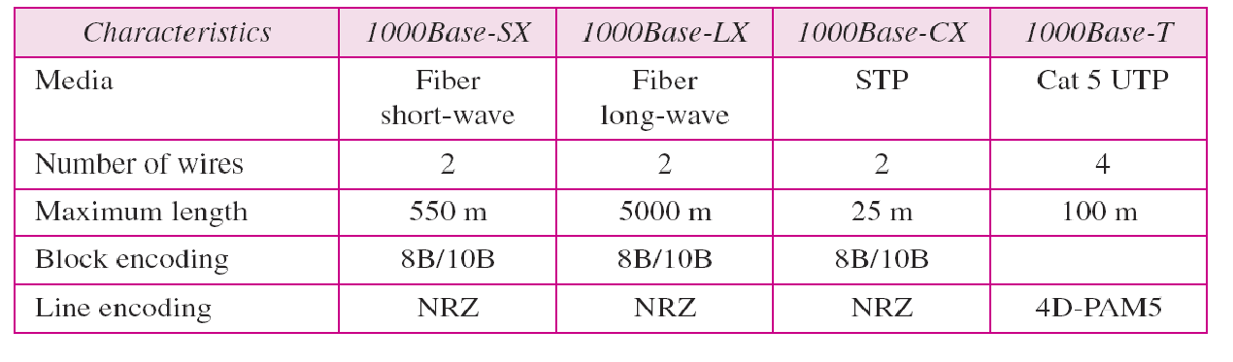
Table 4.3 Summary of Gigabit Ethernet implementations

Slide 27
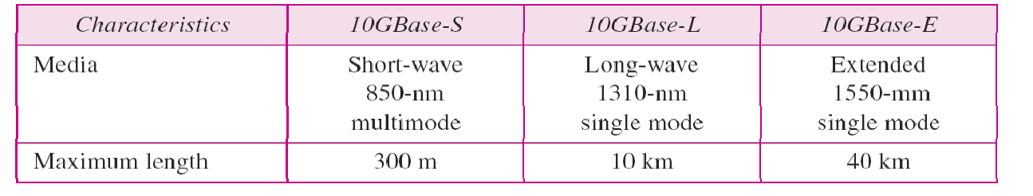
Table 4.4 Summary of Ten-Gigabit Ethernet implementations

